Slide 1
Bromide Concentrations in Surface Drinking Water Sources Dealing with Bromide and Brominated Compounds
This work was prepared in collaboration with Butts County by researchers at the University of Georgia with financial support from Butts County and a SFY2017 Regional Water Plan Seed Grant from the GA EPD.
All photos used in the presentation were found using Google Image Searchers and were labeled for non-commercial reuse.

Slide 2
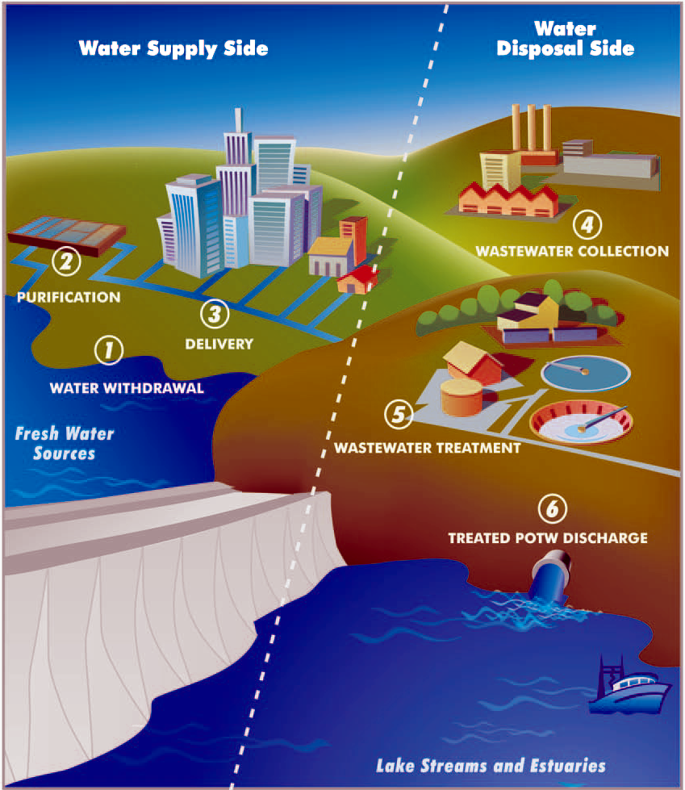
How can bromide be removed from source water?
Notes:
How can bromide be removed from source water?
Currently, there are no cost-effective and practical methods available to remove bromide from source water (Singer 1994). If anthropogenic bromide pollution of source water is stopped, bromide concentrations will be reduced via dilution and fewer brominated disinfection by-products (DBPs) will be present in finished drinking water over time (Good and Vanbriesen 2017). However, if bromide is continually added to source water, there are no cost-effective methods available at an industrial scale to reduce bromide concentrations prior to disinfection or remove brominated DBPs following disinfection. In addition to research and development of new preventative and control technologies, identifying anthropogenic bromide inputs to source water and preventing continued pollution is the best and only practical solution available right now to prevent elevated bromide in source water (Parker et al. 2014).

Slide 3
Despite a lack of practical bromide removal techniques, the impacts of anthropogenic bromide pollution of source water can be partially mitigated by:
Limiting bromide-rich effluent to high-flow conditions when natural dilution is most effective (Weaver et al. 2016).
Reducing the amount of bromide-rich discharge to surface water at one time by pulsing releases (Weaver et al. 2016).
Implementing aquifer storage and recovery, which involves collecting raw source water when water quality is highest and bromide levels are minimal and storing it until needed (Singer 1994).

Slide 4
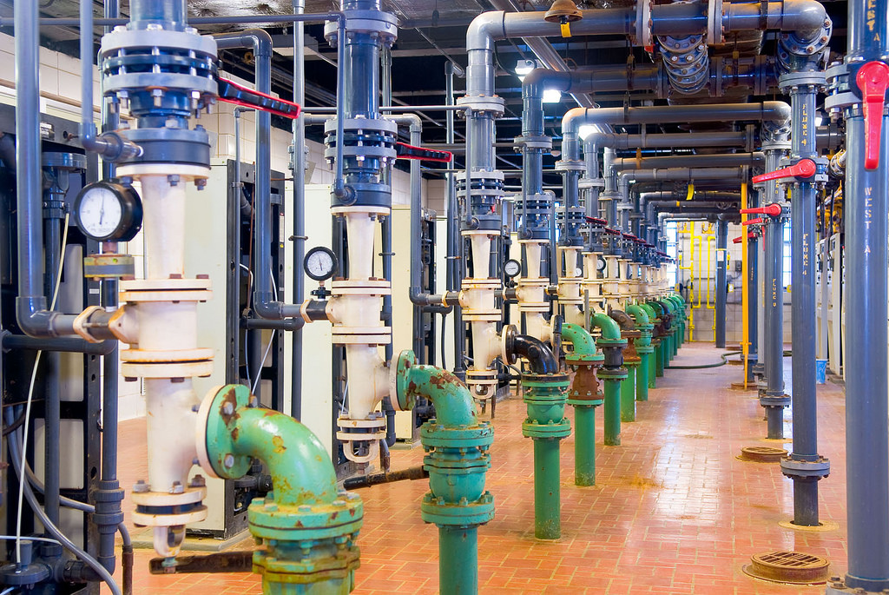
What options exist to change the disinfection process to prevent brominated compounds in finished drinking water?
Notes:
What options exist to change the disinfection process to prevent brominated compounds in finished drinking water?
Although there have been strides in optimizing water treatment processes and water distribution networks to reduce the formation of regulated DBPs, there are currently no cost-effective and practical methods to prevent brominated DBPs from forming in finished drinking water. However, as summarized in Rivera-Utrilla et al. (2019) there are several promising DBP precursor [halide and natural organic matter (NOM)] removal technologies in development that could eventually yield an efficient and economically viable option to reduce DBPs, including membrane, electrochemical, and adsorption methods.

Slide 5
Membrane bromide and NOM removal methods include reverse osmosis (RO), nanofiltration (NF), electrodialysis (ED), and reverse electrodialysis (RED)
Notes:
Membrane bromide and NOM removal methods include reverse osmosis (RO), nanofiltration (NF), electrodialysis (ED), and reverse electrodialysis (RED).
RO involves the high-pressure movement of water through a semi-permeable membrane that rejects halides and other organic pollutants. Although RO is highly effective at removing bromide (99% bromide removed from seawater; Magara et al. 1996), there is a high cost associated with its implementation and maintenance that makes it an unpractical choice for public water utilities.
NF uses reverse osmosis and ultrafiltration to exclude halides and other nuisance compounds. NF is slightly less costly than RO and can remove halides almost as effectively as RO. However, the short operating lives of NF and RO membranes limit their practicality in public water utilities.
In ED, ions are subjected to electrical currents between membranes with opposite charges, which remove them from the water. RED is similar, except that the membrane charges are periodically reversed. ED and RED methods are inexpensive compared to RO and NF, but have their membranes have short operating lives and are less efficient at halide removal.

Slide 6
Electrochemical bromide removal methods include electrolysis and capacitive deionization (CDI)
Notes:
Electrochemical bromide removal methods include electrolysis and capacitive deionization (CDI).
Electrolysis uses an electric current to oxidize bromide to hypobromite and hypobromous acid, which is then volatilized as bromine gas by carbon dioxide. This method has produced a 73% reduction in brominated trihalomethanes, but does not effectively remove NOM.
CDI involves a pair of porous electrodes that generate an electrical current and store halides within electrical layers. Membrane CDI improves halide removal by adding ion-exchange membranes. Although CDI is a promising option for halide removal, there is currently no technology designed for use at an industrial scale.

Slide 7
Adsorption bromide and NOM removal methods include layered double hydroxides, double sol-gel, hydrated oxides, activated carbon-ag, silver-doped carbon aerogels, and magnetic ion-exchange resins
Notes:
Adsorption bromide and NOM removal methods include layered double hydroxides, double sol-gel, hydrated oxides, activated carbon-ag, silver-doped carbon aerogels, and magnetic ion-exchange resins.
Adsorption methods are advantageous because they are easy to implement and cheap to maintain. Unfortunately, some of the materials are less selective for bromide, meaning that they do not remove the ion as effectively as the electrochemical and membrane methods. Depending on the compounds present in the source water, bromide might compete with organic material and other charged molecules for adsorption surface meaning that fewer bromide ions are successfully removed from the water.

Slide 8
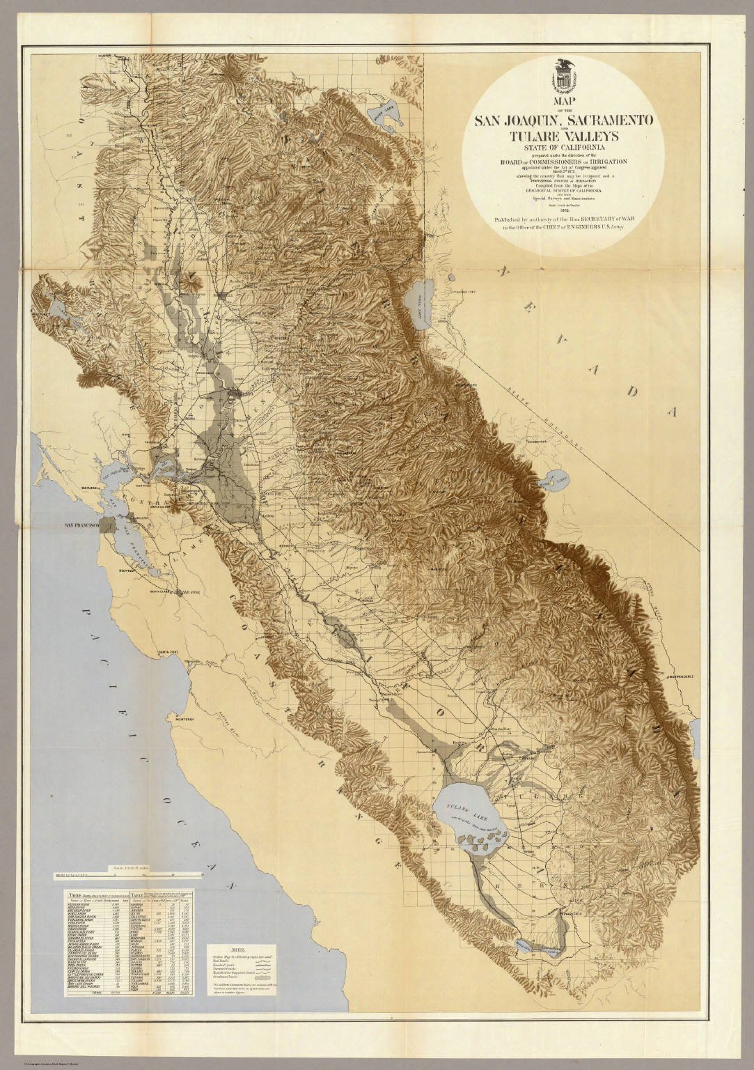
California’s Sacramento-San Joaquin Delta
Notes:
California’s Sacramento-San Joaquin Delta
The Sacramento-San Joaquin Delta provides source water for 23 million people living in California. The demand for water and water scarcity has surged over the past few decades, while the delta’s water quality has steadily declined due to increased salinity and total organic carbon (TOC; Chow et al. 2007). The delta’s bromide levels have increased due to saltwater intrusion, while TOC increase has been associated with agricultural runoff (Lund et al. 2015). California water utilities have addressed the declining water quality by implementing alternative disinfectants and by exploiting alternative water sources when the delta’s water quality is too poor (bromide and TOC levels have seasonal shifts) for safe disinfection practices (CALFED 2005). Updating the water treatment plants and using alternative disinfectants has allowed California’s water utilities to comply with DBP regulations. However, changes to the water treatment process are expensive and more updates will be necessary to cope with further declines in water quality. Rising sea levels and the failure of subsided western islands will present grand challenges for California’s drinking water utilities in the near future (Chen et al. 2010).

Slide 9
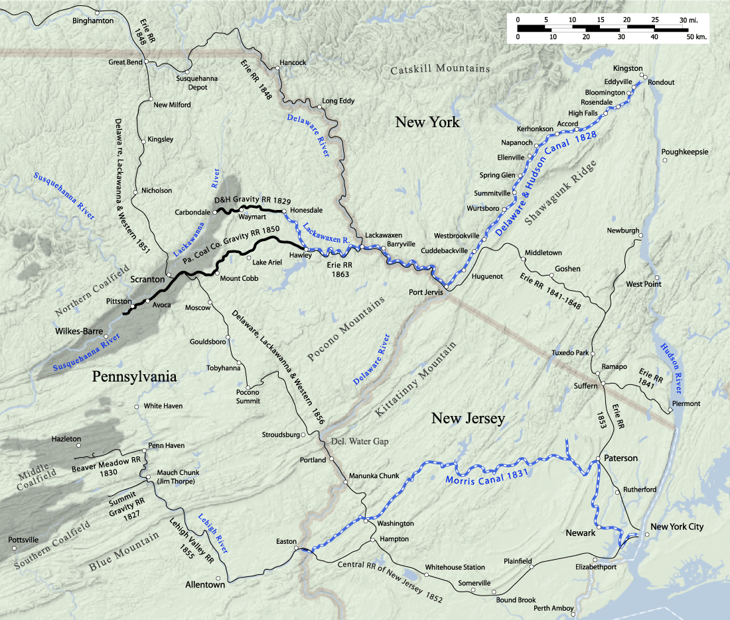
Pennsylvania’s Allegheny River Basin
Notes:
Pennsylvania’s Allegheny River Basin
Over 1.5 million people rely on the Pennsylvania’s Allegheny River Basin as a drinking water source. Recently, dramatically elevated levels of bromide in the Allegheny River Basin’s surface water has been attributed to wastewater from coal-fired power plants using bromine addition to control mercury emissions. Specifically, bromine is added to wet flue gas desulfurization (FGD) systems and high levels of bromide are present in wastewater. Although this wastewater is sent to wastewater treatment plants, the bromide is not removed and ends up in surface water. Researchers have documented bromide levels as high as 299 ug/L (States et al. 2013) and 599 ug/L (Wilson and VanBriesen 2012) in PA watersheds receiving coal-fired power plant wastewater discharges. Several papers from Carnegie Mellon University’s Dr. Jeanne VanBriesen and colleagues have highlighted how bromine addition to wet FGD systems will elevate surface water bromide and subsequently increase brominated disinfection by-product formation in drinking water (VanBriesen 2013, 2014, Wang et al. 2016, Kolb et al. 2017). No practical solutions have been identified to remove bromide from source water (Good and VanBriesen 2019).

Slide 10
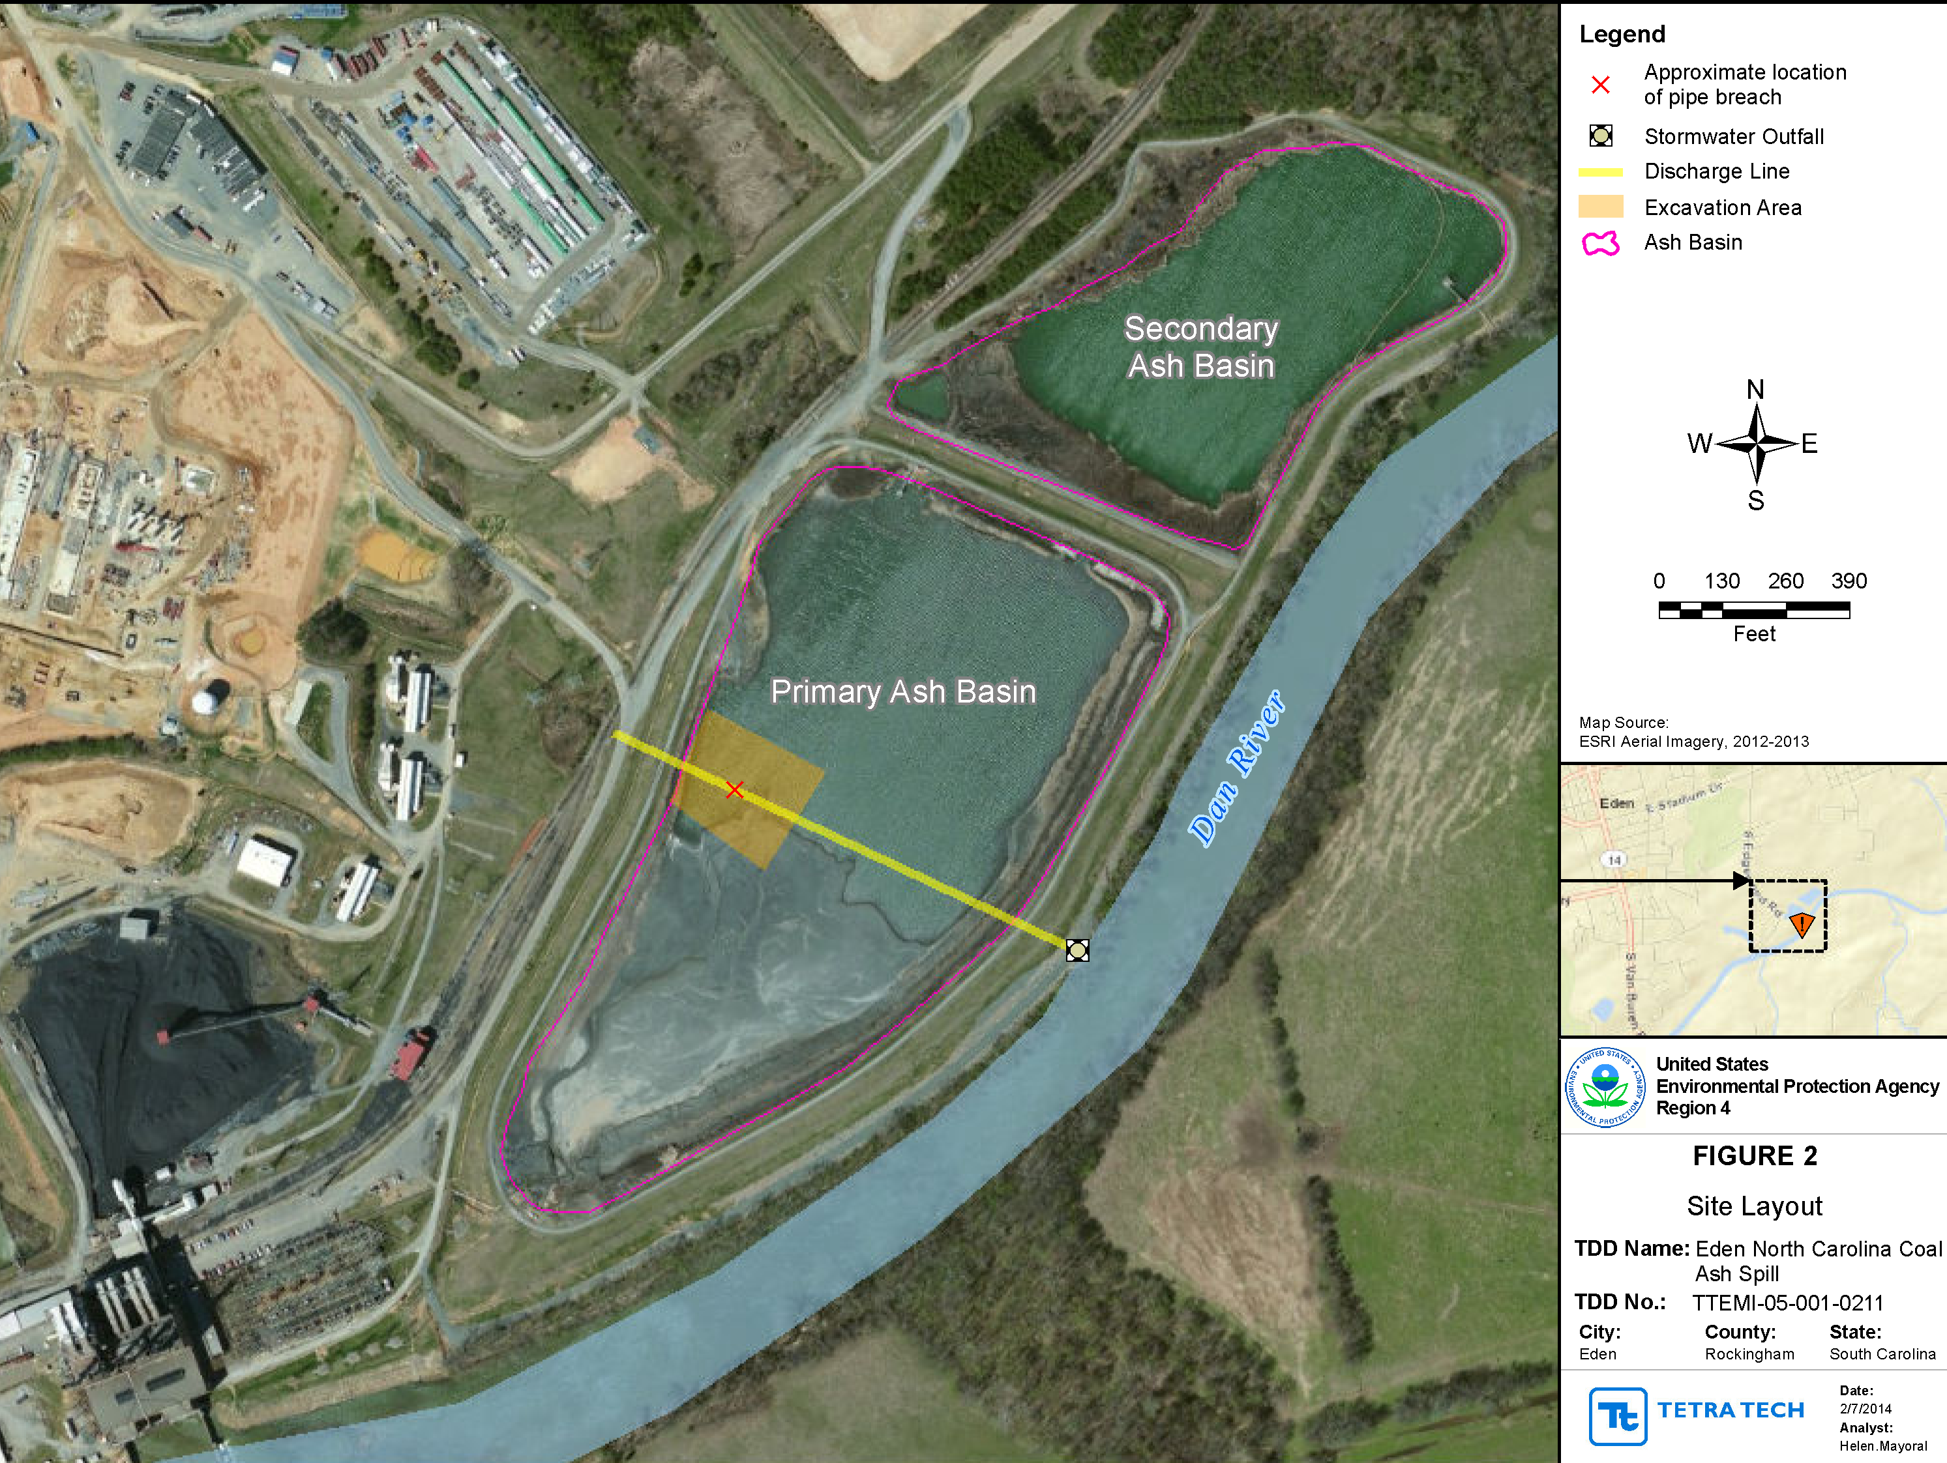
Coal Ash Basin Spills in North Carolina Rivers (Duke Energy Corporation 2015)
Notes:
Coal Ash Basin Spills in North Carolina Rivers (Duke Energy Corporation 2015)
In 2014, a coal ash basin at a facility owned by Duke Energy contaminated surface waters of the Dan River in Eden, North Carolina. Heavy metals and bromide present in the coal ash spread throughout NC and downriver to the North Carolina-Virginia border. A similar leak occurred at a Duke Energy steam electric plant that resulted in pollution of the Cape Fear River. Also, Duke Energy coal combustion facilities also knowingly discharged coal ash contents without permits into surface waters. Finally, although it was not a violation of US EPA regulations, Duke Energy’s coal-fired power plants wet flue gas desulfurization systems used bromine-addition for mercury control, which further elevated surface water bromide levels throughout the state following wastewater discharge. The elevated bromide levels in various drinking water sources throughout North Carolina and Virginia lead to elevated disinfection by-product formation and an inability to meet US EPA regulations regarding trihalomethane and haloacetic acid levels (Greune 2014). Drinking water utilities upgraded their facilities to deal with the elevated bromide levels and purchased water from other facilities to meet customer needs in the meantime. Duke Energy plead guilty to nine violations of the Clean Water Act and has been working with a court-appointed monitor to achieve environmental compliance obligations (Duke Energy Corporation 2019).

Slide 11
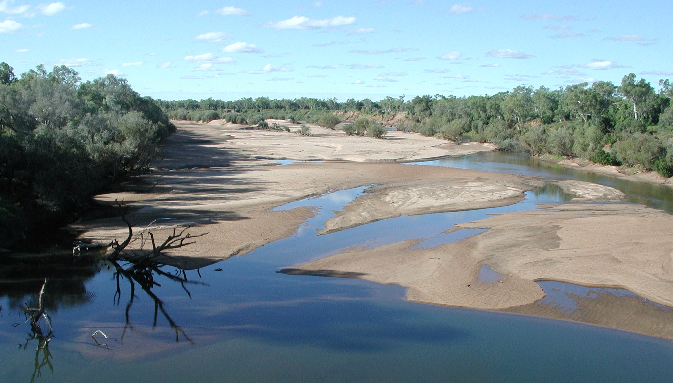
Bromide and Iodide in Western Australia’s Surface Waters
Notes:
Bromide and Iodide in Western Australia’s Surface Waters
Drinking water treatment in Western Australia is challenging because of high concentrations of DBP precursors: NOM (0.4-16 mg/L), bromide (400-8450 ug/L), and iodide (5-593 ug/L) in the source water (Gruchlik et al. 2015). It is especially concerning when source water contains high levels of bromide and and iodide because brominated and iodinated DBPs are thought to be more cytotoxic and carcinogenic than their chlorinated analogs (Wagner and Plewa 2017). Saltwater intrusion and aridity contribute to elevated bromide and iodide levels in Western AU. Although there are several effective NOM removal methods, these methods do not remove halides and can lead to greater formation brominated DBPs when the source water bromide levels are elevated (Kristiana et al. 2011). Recent work has identified pre-ozonation followed by chloramination as a potential method to reduce iodinated DBPs because ozone oxidizes iodide to iodate. Unfortunately, practical bromide removal methods are still lacking (Gruchlik et al. 2015).

Slide 12
CALFED. 2005. Issues with Delta Drinking Water Treatment. http://www.calwater.ca.gov/content/Documents/Issues_Delta_Drinking_Water_Treatment_2005.pdf.
Chen, W.-H., K. Haunschild, J. R. Lund, and W. E. Fleenor. 2010. Current and long-term effects of Delta water quality on drinking water treatment costs from disinfection byproduct formation. San Francisco Estuary and Watershed Science 8:1–21.
Chow, A. T., R. A. Dahlgren, and J. A. Harrison. 2007. Watershed sources of disinfection byproduct precursors in the Sacramento and San Joaquin Rivers, California. Environmental Science and Technology 41:7645–7652.
Duke Energy Corporation. 2015. Joint Factual Statement: United States of America v. Duke Energy Buisiness Services, LLC, Duke Energy Carolinas, LLC, and Duke Energy Progress, Inc.
Duke Energy Corporation. 2019. Environmental Compliance Plans. https://www.duke-energy.com/our-company/environment/compliance-and-reporting/environmental-compliance-plans.
Good, K. D., and J. M. Vanbriesen. 2017. Power Plant Bromide Discharges and Downstream Drinking Water Systems in Pennsylvania. Environmental Science and Technology 51:11829–11838.
Good, K. D., and J. M. VanBriesen. 2019. Coal-Fired Power Plant Wet Flue Gas Desulfurization Bromide Discharges to U.S. Watersheds and Their Contributions to Drinking Water Sources. Environmental Science and Technology 53:213–223.
Greune, A. C. 2014. Bromide occurrence in North Carolina and the relationship between bromide concentration and brominated trihalomethane formation (MS Thesis). North Carolina State University.
Gruchlik, Y., A. Heitz, C. Joll, U. von Gunten, S. Allard, J. Criquet, S. McDonald, J. Tan, L. Breckler, F. Bradder, G. Roeszler, and D. Halliwell. 2015. CWQRC-2015-004. Novel Treatment Technologies for the Minimisation of Bromide and Iodide in Drinking Water.
Kolb, C., R. A. Francis, and J. M. VanBriesen. 2017. Disinfection byproduct regulatory compliance surrogates and bromide-associated risk. Journal of Environmental Sciences 58:191–207.
Kristiana, I., C. Joll, and A. Heitz. 2011. Powdered activated carbon coupled with enhanced coagulation for natural organic matter removal and disinfection by-product control: Application in a Western Australian water treatment plant. Chemosphere.
Lund, J. R., W. Chen, K. Haunschild, and W. Fleenor. 2015. Current and Long-Term Effects of Delta Water Quality on Drinking Water Treatment Costs from Disinfection Byproduct Formation. San Francisco Estuary and Watershed Science 8.
Parker, K. M., T. Zeng, J. Harkness, A. Vengosh, and W. A. Mitch. 2014. Enhanced formation of disinfection byproducts in shale gas wastewater-impacted drinking water supplies. Environmental Science and Technology 48:11161–11169.
Rivera-Utrilla, J., M. Sánchez-Polo, A. M. S. Polo, J. J. López-Peñalver, and M. V. López-Ramón. 2019. New technologies to remove halides from water: An overview. Pages 147–180 in R. Prasad and T. Karchiyappan, editors. Advanced Research in Nanosciences for Water Technology. Nanotechnology in the Life Sciences. Springer, Cham.
Singer, P. C. 1994. Control of disinfection by-products in drinking water. Journal of Environmental Engineering 120:727–744.
States, S., G. Cyprych, M. Stoner, F. Wydra, J. Kuchta, J. Monnell, and L. Casson. 2013. Marcellus Shale drilling and brominated THMs in Pittsburgh, Pa., drinking water. Journal - American Water Works Association.
Valero, F., and R. Arbós. 2010. Desalination of brackish river water using Electrodialysis Reversal (EDR). Control of the THMs formation in the Barcelona (NE Spain) area. Desalination 253:170–174.
Valero, F., A. Barcelo, and R. Arbos. 2012. Electrodialysis Technology - Theory and Applications. Page Desalination, Trends and Technologies.
VanBriesen, J. M. 2013. Potential drinking water effects of bromide discharges from coal-fired electric power plants. Formal Comments of the Environmental Integrity Project et al. on the Effluent Limitations Guidelines and Standards for the Steam Electric Power Generating Point Source Category, Appendix B of Water Docket EPA-HQ-OW-2009-0819-4687:1–38.
VanBriesen, J. M. 2014. Potential drinking water effects of bromide discharges from coal-fired electric power plants. EPA NPDES Comments:1–38.
Wagner, E. D., and M. J. Plewa. 2017. CHO cell cytotoxicity and genotoxicity analyses of disinfection by-products: An updated review. Journal of Environmental Sciences (China) 58:64–76.
Wang, Y., M. J. Small, and J. M. VanBriesen. 2016. Assessing the Risk Associated with Increasing Bromide in Drinking Water Sources in the Monongahela River, Pennsylvania. Journal of Environmental Engineering 143:04016089.
Weaver, J. W., J. Xu, and S. C. Mravik. 2016. Scenario Analysis of the Impact on Drinking Water Intakes from Bromide in the Discharge of Treated Oil and Gas Wastewater. Journal of Environmental Engineering.
Wilson, J. M., and J. M. VanBriesen. 2012. Research article: Oil and gas produced water management and surface drinking water sources in Pennsylvania. Environmental Practice
Notes:
CALFED. 2005. Issues with Delta Drinking Water Treatment. http://www.calwater.ca.gov/content/Documents/Issues_Delta_Drinking_Water_Treatment_2005.pdf.
Chen, W.-H., K. Haunschild, J. R. Lund, and W. E. Fleenor. 2010. Current and long-term effects of Delta water quality on drinking water treatment costs from disinfection byproduct formation. San Francisco Estuary and Watershed Science 8:1–21.
Chow, A. T., R. A. Dahlgren, and J. A. Harrison. 2007. Watershed sources of disinfection byproduct precursors in the Sacramento and San Joaquin Rivers, California. Environmental Science and Technology 41:7645–7652.
Duke Energy Corporation. 2015. Joint Factual Statement: United States of America v. Duke Energy Buisiness Services, LLC, Duke Energy Carolinas, LLC, and Duke Energy Progress, Inc.
Duke Energy Corporation. 2019. Environmental Compliance Plans. https://www.duke-energy.com/our-company/environment/compliance-and-reporting/environmental-compliance-plans.
Good, K. D., and J. M. Vanbriesen. 2017. Power Plant Bromide Discharges and Downstream Drinking Water Systems in Pennsylvania. Environmental Science and Technology 51:11829–11838.
Good, K. D., and J. M. VanBriesen. 2019. Coal-Fired Power Plant Wet Flue Gas Desulfurization Bromide Discharges to U.S. Watersheds and Their Contributions to Drinking Water Sources. Environmental Science and Technology 53:213–223.
Greune, A. C. 2014. Bromide occurrence in North Carolina and the relationship between bromide concentration and brominated trihalomethane formation (MS Thesis). North Carolina State University.
Gruchlik, Y., A. Heitz, C. Joll, U. von Gunten, S. Allard, J. Criquet, S. McDonald, J. Tan, L. Breckler, F. Bradder, G. Roeszler, and D. Halliwell. 2015. CWQRC-2015-004. Novel Treatment Technologies for the Minimisation of Bromide and Iodide in Drinking Water.
Kolb, C., R. A. Francis, and J. M. VanBriesen. 2017. Disinfection byproduct regulatory compliance surrogates and bromide-associated risk. Journal of Environmental Sciences 58:191–207.
Kristiana, I., C. Joll, and A. Heitz. 2011. Powdered activated carbon coupled with enhanced coagulation for natural organic matter removal and disinfection by-product control: Application in a Western Australian water treatment plant. Chemosphere.
Lund, J. R., W. Chen, K. Haunschild, and W. Fleenor. 2015. Current and Long-Term Effects of Delta Water Quality on Drinking Water Treatment Costs from Disinfection Byproduct Formation. San Francisco Estuary and Watershed Science 8.
Parker, K. M., T. Zeng, J. Harkness, A. Vengosh, and W. A. Mitch. 2014. Enhanced formation of disinfection byproducts in shale gas wastewater-impacted drinking water supplies. Environmental Science and Technology 48:11161–11169.
Rivera-Utrilla, J., M. Sánchez-Polo, A. M. S. Polo, J. J. López-Peñalver, and M. V. López-Ramón. 2019. New technologies to remove halides from water: An overview. Pages 147–180 in R. Prasad and T. Karchiyappan, editors. Advanced Research in Nanosciences for Water Technology. Nanotechnology in the Life Sciences. Springer, Cham.
Singer, P. C. 1994. Control of disinfection by-products in drinking water. Journal of Environmental Engineering 120:727–744.
States, S., G. Cyprych, M. Stoner, F. Wydra, J. Kuchta, J. Monnell, and L. Casson. 2013. Marcellus Shale drilling and brominated THMs in Pittsburgh, Pa., drinking water. Journal - American Water Works Association.
Valero, F., and R. Arbós. 2010. Desalination of brackish river water using Electrodialysis Reversal (EDR). Control of the THMs formation in the Barcelona (NE Spain) area. Desalination 253:170–174.
Valero, F., A. Barcelo, and R. Arbos. 2012. Electrodialysis Technology - Theory and Applications. Page Desalination, Trends and Technologies.
VanBriesen, J. M. 2013. Potential drinking water effects of bromide discharges from coal-fired electric power plants. Formal Comments of the Environmental Integrity Project et al. on the Effluent Limitations Guidelines and Standards for the Steam Electric Power Generating Point Source Category, Appendix B of Water Docket EPA-HQ-OW-2009-0819-4687:1–38.
VanBriesen, J. M. 2014. Potential drinking water effects of bromide discharges from coal-fired electric power plants. EPA NPDES Comments:1–38.
Wagner, E. D., and M. J. Plewa. 2017. CHO cell cytotoxicity and genotoxicity analyses of disinfection by-products: An updated review. Journal of Environmental Sciences (China) 58:64–76.
Wang, Y., M. J. Small, and J. M. VanBriesen. 2016. Assessing the Risk Associated with Increasing Bromide in Drinking Water Sources in the Monongahela River, Pennsylvania. Journal of Environmental Engineering 143:04016089.
Weaver, J. W., J. Xu, and S. C. Mravik. 2016. Scenario Analysis of the Impact on Drinking Water Intakes from Bromide in the Discharge of Treated Oil and Gas Wastewater. Journal of Environmental Engineering.
Wilson, J. M., and J. M. VanBriesen. 2012. Research article: Oil and gas produced water management and surface drinking water sources in Pennsylvania. Environmental Practice

