Slide 1
Bromide Concentrations in Surface Drinking Water Sources Water Disinfection By-Products and Increasing Bromide in Source Water
This work was prepared in collaboration with Butts County by researchers at the University of Georgia with financial support from Butts County and a SFY2017 Regional Water Plan Seed Grant from the GA EPD.
All photos used in the presentation were found using Google Image Searchers and were labeled for non-commercial reuse.

Slide 2
What are disinfection by-products?
Notes:
What are disinfection by-products?
Disinfection by-products (DBPs) are compounds created unintentionally when halides (bromide and iodine) and other pollutants react with natural organic matter present in source water and disinfectants (chlorine, chloramine, ozone, chlorine dioxide, and UV) during drinking water treatment processes (Charrois and Hrudey 2012). Around 700 DBPs have been discovered worldwide, but only a subset of these have been evaluated for risks to human health (Richardson et al. 2007). Along with bromate and chlorate, the 11 regulated species of DBPs include trihalomethanes (referred to as TTHMs or THM4) and haloacetic accids (HAAs or HAA5). There are 4 other bromine-containing haloacetic acids that are not regulated but are monitored as a part of HAA6Br and HAA9. The following table from Cortés and Marco (2018) summarizes the major classes of DBP and their occurrence values:

Slide 3
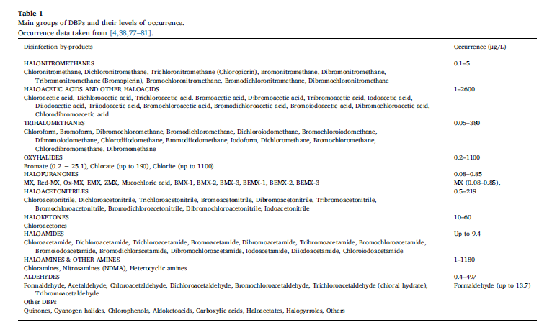
Notes:
What are disinfection by-products?
Disinfection by-products (DBPs) are compounds created unintentionally when halides (bromide and iodine) and other pollutants react with natural organic matter present in source water and disinfectants (chlorine, chloramine, ozone, chlorine dioxide, and UV) during drinking water treatment processes (Charrois and Hrudey 2012). Around 700 DBPs have been discovered worldwide, but only a subset of these have been evaluated for risks to human health (Richardson et al. 2007). Along with bromate and chlorate, the 11 regulated species of DBPs include trihalomethanes (referred to as TTHMs or THM4) and haloacetic accids (HAAs or HAA5). There are 4 other bromine-containing haloacetic acids that are not regulated but are monitored as a part of HAA6Br and HAA9. The following table from Cortés and Marco (2018) summarizes the major classes of DBP and their occurrence values:

Slide 4
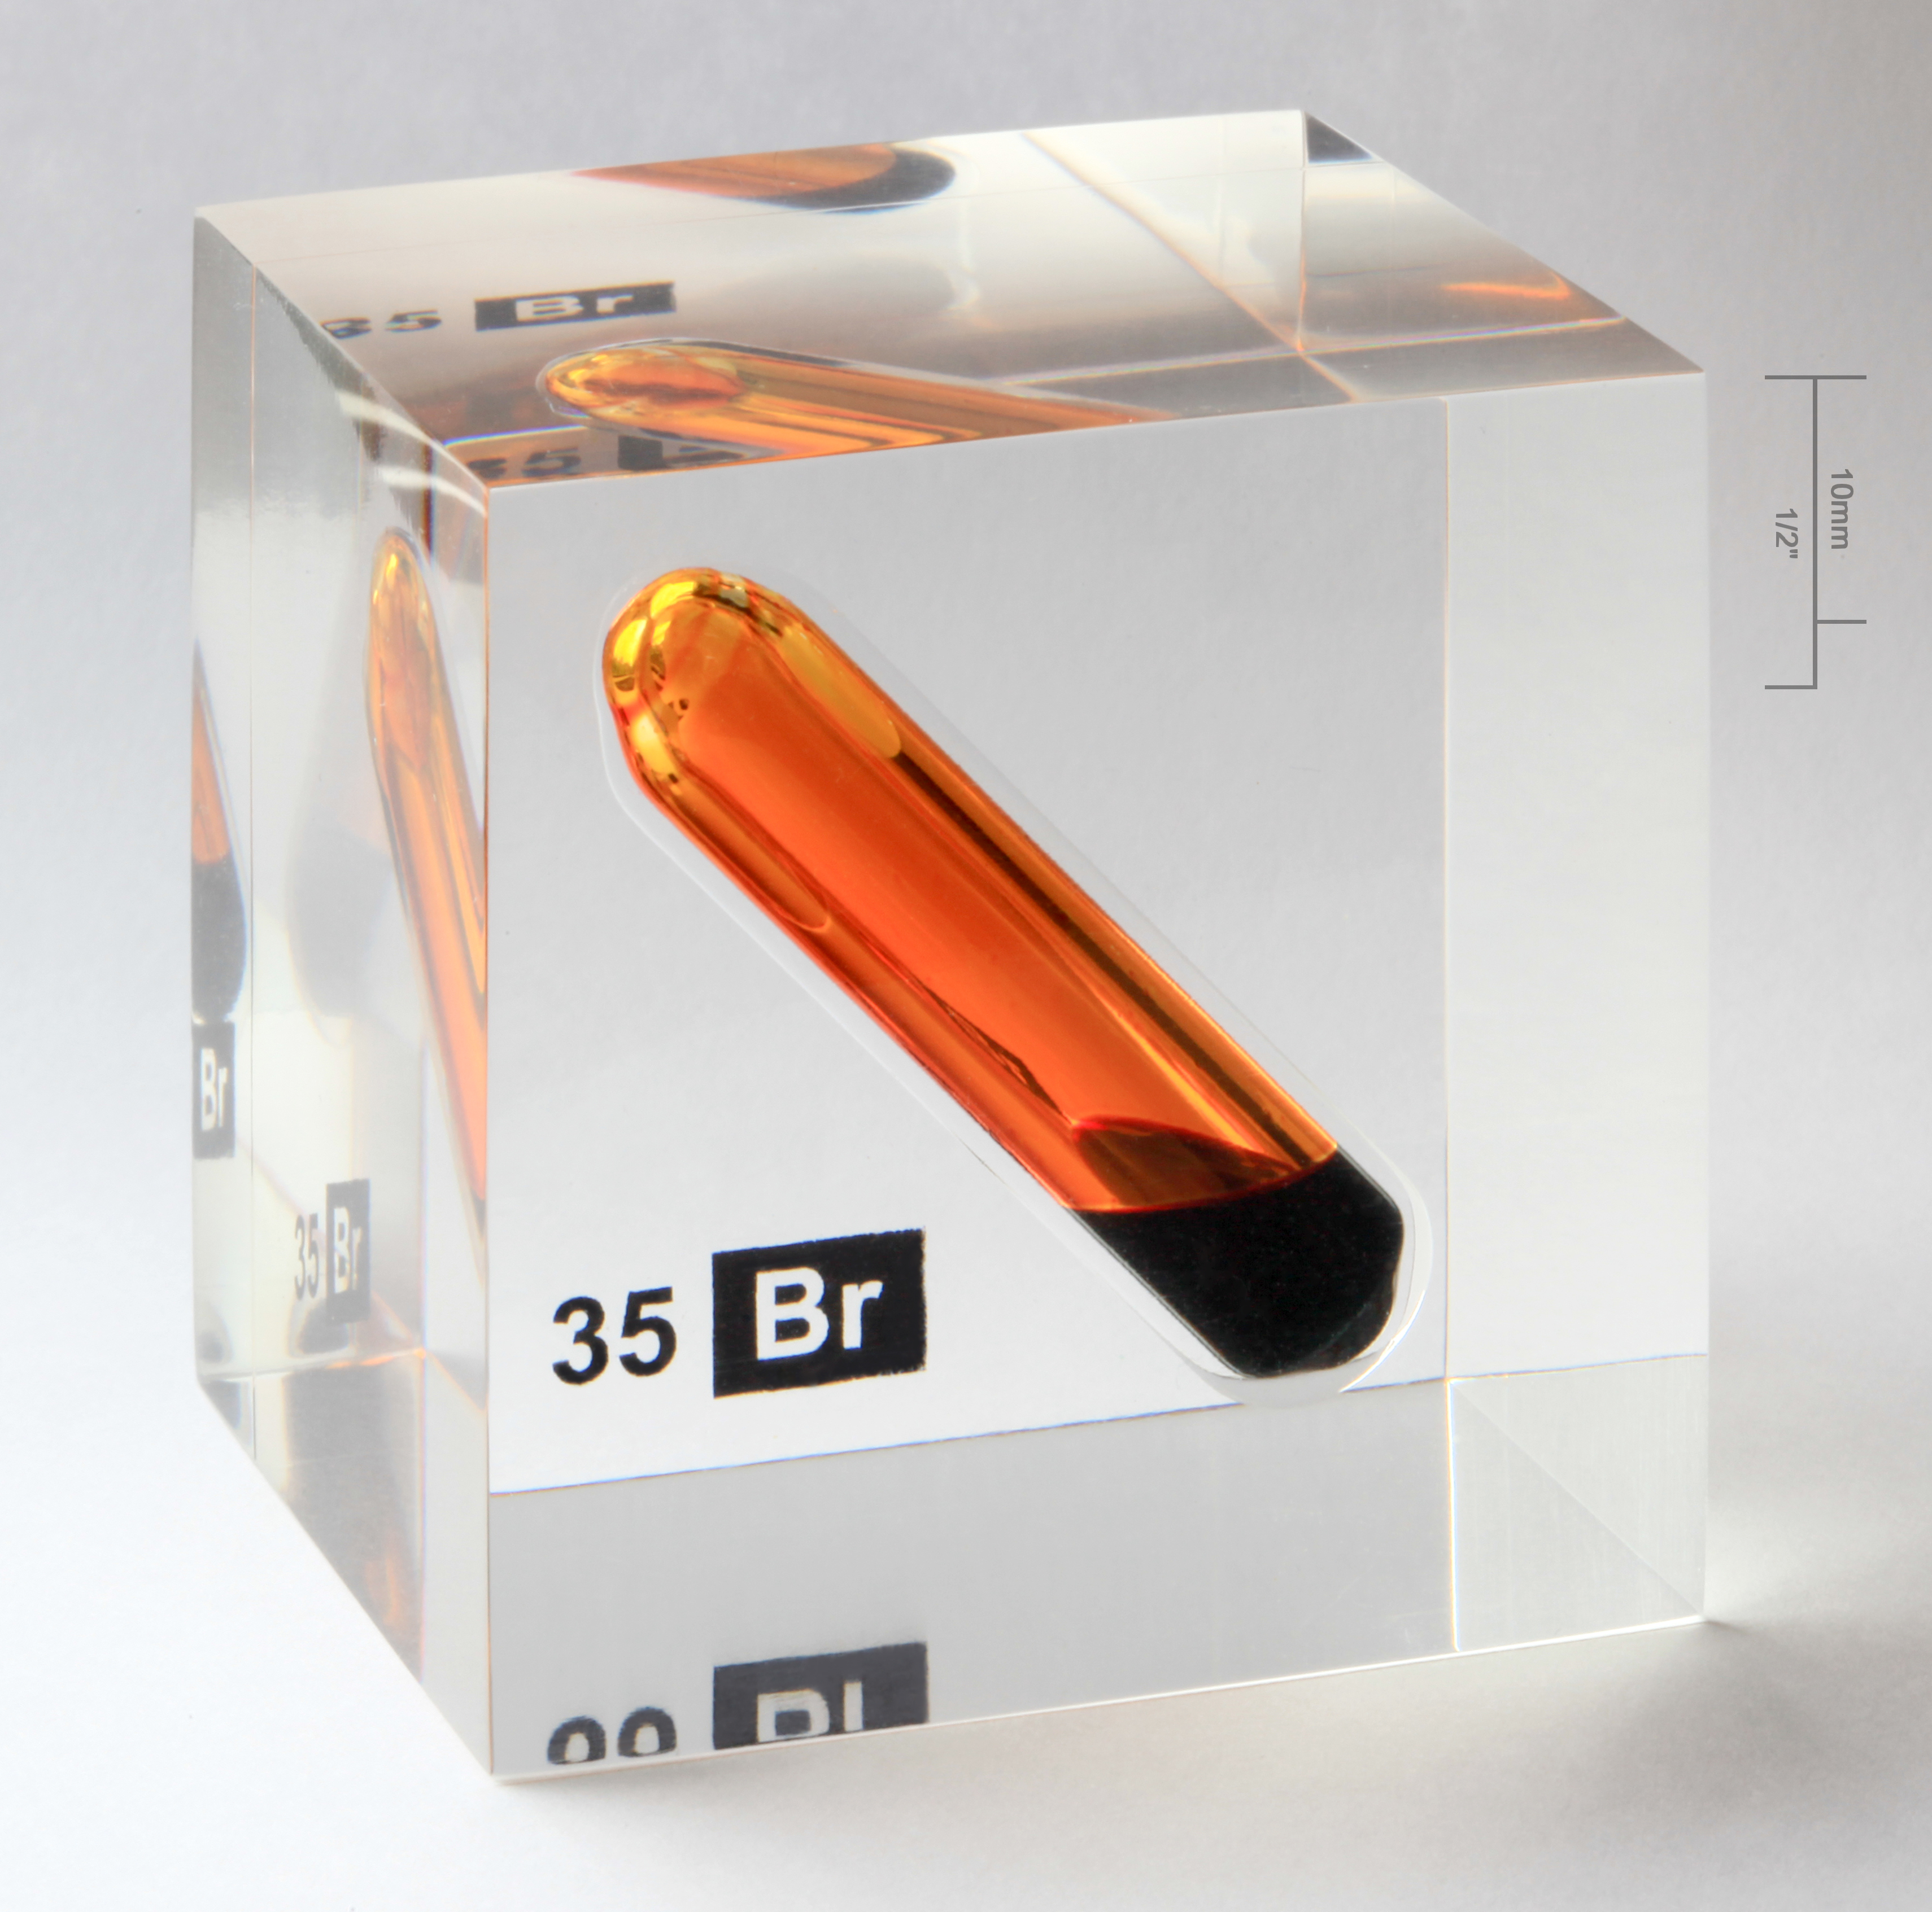
What are the processes that create brominated compounds?
Notes:
What are the processes that create brominated compounds?
During chlorination (disinfection with chlorine), bromide is oxidized to hypobromous acid (HOBr), which reacts with NOM to form brominated DBPs, including bromoform, trihalomethanes, and haloacetic acids (Heeb et al. 2014). Alternatively, during ozonation hypobromous reacts with ozone (O₃) to primarily form bromate (BrO₃-) (additional formation reactions discussed in von Gunten 2003). Thus, depending on which types of disinfectants are used and the characteristics of the natural organic matter present in the source water, there are several processes that can create brominated DBPs (Heeb et al. 2014). As summarized in Regli et al. (2015), elevated bromide in source waters leads to brominated DBP formation following chlorination (Krasner et al. 1989, Petri et al. 1997, Obolensky and Singer 2005), chloramination (Diehl et al. 2000), ozonation (Richardson et al. 1999), disinfection with chlorine dioxide (Richardson et al. 2003), and combinations of these disinfects through a variety of chemical reactions. Detailed descriptions of chemical reactions that create brominated DBPs can be found in von Gunten 2003, Heeb et al. 2014, Sharma et al. 2014.

Slide 5
What are the human health risks to exposure?
Notes:
What are the human health risks to exposure?
Bromide in itself is not a risk to human or ecosystem health when present in source water (WHO 2009). The levels of bromide that are toxic to humans and other species are much higher than most natural environmental bromide concentrations. In fact, since natural background levels of bromide are so low in the environment (except in seawater, shales, and coastal groundwater and soils), bromide has been regularly used in environmental studies as a nonreactive tracer to study water and solute movement in soils (Flury and Papritz 1993).
In contrast, the brominated DBPs formed when bromide reacts with natural organic matter present in source water and chemical oxidants during drinking water decontamination processes may represent serious risks to human health (Rook 1974, Charrois and Hrudey 2012). Across all classes of DBPs, toxicological studies using a variety of in vitro (Salmonella typhimurium and Chinese hamster ovary assays) and in vivo (rodent and fish bioassays), indicate cytotoxic, neurotoxic, mutagenic, genotoxic, carcinogenic, and teratogenic consequences of DBP exposure (Reviewed in Richardson et al. 2007). The following table from Richardson et al. (2007) summarizes toxicological findings for the regulated DBPs:

Slide 6
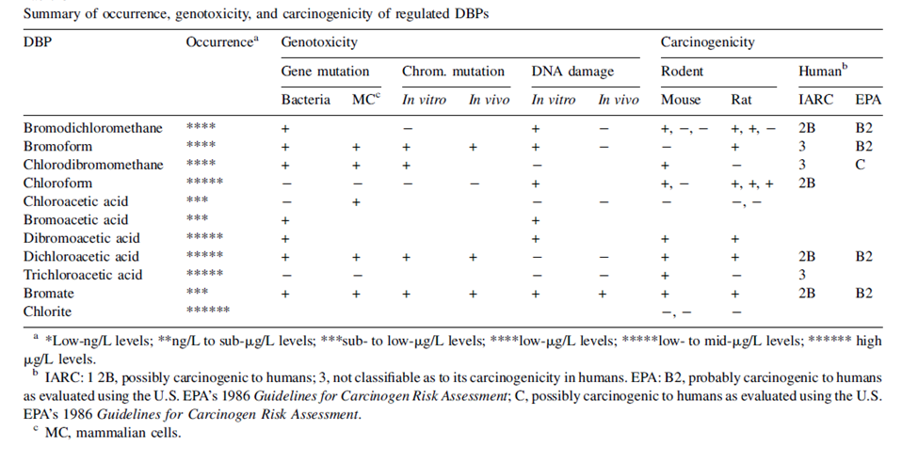
Notes:
What are the human health risks to exposure?
In contrast, the brominated DBPs formed when bromide reacts with natural organic matter present in source water and chemical oxidants during drinking water decontamination processes may represent serious risks to human health (Rook 1974, Charrois and Hrudey 2012). Across all classes of DBPs, toxicological studies using a variety of in vitro (Salmonella typhimurium and Chinese hamster ovary assays) and in vivo (rodent and fish bioassays), indicate cytotoxic, neurotoxic, mutagenic, genotoxic, carcinogenic, and teratogenic consequences of DBP exposure (Reviewed in Richardson et al. 2007). The following table from Richardson et al. (2007) summarizes toxicological findings for the regulated DBPs:
Regulated and unregulated brominated DBPs are particularly concerning because they are more carcinogenic than their chlorinated analogs in animal studies (Wagner and Plewa 2017). It is important to note that a growing number of toxicological studies show that emerging DBPs containing iodine and nitrogen are even more carcinogenic and cytotoxic than brominated DBPs, although they are typically present in finished drinking water at much lower quantities (Wagner and Plewa 2017).

Slide 7
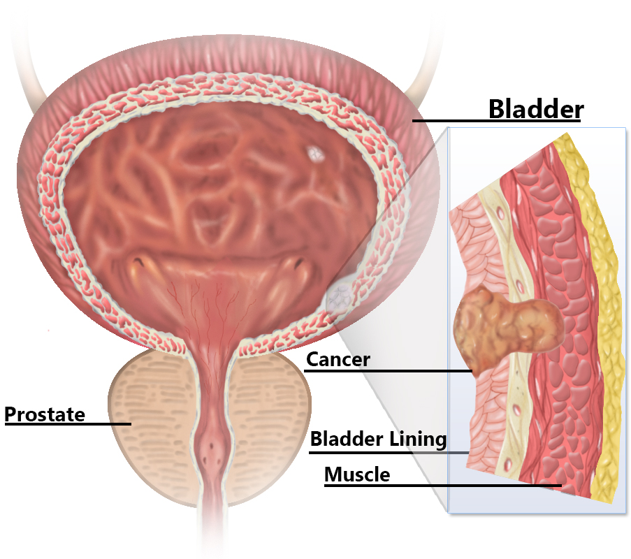
What are the human health risks to exposure?
Notes:
What are the human health risks to exposure?
Since the 1980s, several epidemiological studies have investigated whether exposure to DBPs in chlorinated water is associated with negative human health consequences, including cancer and reproductive effects (Charrois and Hrudey 2012, Grellier et al. 2015, Villanueva et al. 2015). There is consistent evidence from individual studies and meta-analyses of an association between urinary bladder cancer and DBP exposure, typically measured as trihalomethane (THM) or halocetic acid (HAA) concentration (Villanueva et al. 2003, 2004, Costet et al. 2011). It is important to note that a mechanism for THMs or HAAs to contribute to bladder cancer has not been identified and therefore support for a causal relationship between THMs or HAAs and bladder cancer is weak (Charrois and Hrudey 2012). Nevertheless, the consistent association of chlorinated water consumption with urinary bladder cancer is a cause for concern and more research is necessary to identify the classes or species of DBPs driving this relationship (Charrois and Hrudey 2012). Several studies have looked for associations between DBP exposure and colon (Doyle et al. 1997, King et al. 2000) and rectal (Hildesheim et al. 1998, Bove et al. 2007) cancer, but results between studies are inconsistent, so this relationship is considered inconclusive (Rahman et al. 2010). Further, recent critical reviews have highlighted methodological problems that limit confidence in the findings of these studies (Charrois and Hrudey 2012, Grellier et al. 2015).
Studies investigating the adverse effects of DBP exposure (again, typically measured as THM or HAA concentration) on fertility, pregnancy, and fetal development have yielded inconsistent and controversial results (Nieuwenhuijsen et al. 2009, 2010, Mitra et al. 2009, Grellier et al. 2010, Villanueva et al. 2015). Similar to the concerns regarding results that associate DBP exposure with colon and rectal cancer, the current links between DBP exposure and negative reproductive outcomes are inconclusive (Charrois and Hrudey 2012, Grellier et al. 2015, Villanueva et al. 2015). However, there is some evidence of an association between THM exposure and fetal growth, specifically weight according to gestational age (small for gestational age; Grellier et al. 2010). Fertility endpoints that have been studied in response to DBP exposure include sperm quality and menstruation cycle length, but findings have been inconsistent. One study found an association between tap water consumption (THM levels greater than 75 µg/L) during pregnancy and an increased risk of spontaneous abortion (Waller et al. 1998). However, this finding has not been confirmed in subsequent studies with improved DBP exposure estimates (Savitz et al. 2006).

Slide 8
What is the relationship between organic matter, bromide, and brominated compounds?
Notes:
What is the relationship between organic matter, bromide, and brominated compounds?
Brominated DBPs are created when bromide, natural organic matter (NOM), and chemical disinfectants react during drinking water decontamination. Specifically, bromide is oxidized to hypobromous acid and then bromine is substituted into organic structures present in NOM (Heeb et al. 2014). Although chlorine and bromine compete for organic reaction sites, bromine is more efficient at substitution and has faster reaction kinetics than chlorine (Westerhoff et al. 2004). Natural organic matter is composed of humic substances, hydrophilic acids, protein, lipids, carbohydrates, carboxylic acid, amino acid, and hydrocarbons, in quantities that vary geographically and seasonally (Westerhoff et al. 2004). Although groups of compounds commonly found in NOM have been investigated as indicators of potential DBP formation, the specific UV absorbance at 254 nm (SUVA₂₅₄) of a water sample (which depends on the nature of NOM present) has been established as a reliable predictor of DBP formation (Ersan et al. 2019). Recent experimental work has demonstrated increased trihalomethane and haloacetic acid formation with increasing SUVA₂₅₄ (Ersan et al. 2019). The removal of NOM prior to disinfection can reduce overall DBP formation, but when the source water also contains high levels of bromide, increasing the bromide:NOM ratio can lead to proportionally greater brominated DBPs (Kristiana et al. 2011). Independent of NOM characteristics, several studies have confirmed that greater bromide concentrations in source water results in greater brominated DBP formation (Cowman and Singer 1996, States et al. 2013, Mctigue et al. 2014). Finally, cytotoxicity has been shown to significantly increase with greater bromide levels in source water and greater brominated DBP formation (Sawade et al. 2016, Ersan et al. 2019).

Slide 9
Bove, G. E., P. A. Rogerson, and J. E. Vena. 2007. Case control study of the geographic variability of exposure to disinfectant byproducts and risk for rectal cancer. International Journal of Health Geographics 6:1–12.
Charrois, J., and S. Hrudey. 2012. Disinfection By-Products and Human Health. IWA Publishing, London.
Cortés, C., and R. Marcos. 2018. Genotoxicity of disinfection byproducts and disinfected waters: A review of recent literature. Mutation Research - Genetic Toxicology and Environmental Mutagenesis 831:1–12.
Costet, N., C. M. Villanueva, J. J. K. Jaakkola, M. Kogevinas, K. P. Cantor, W. D. King, C. F. Lynch, M. J. Nieuwenhuijsen, and S. Cordier. 2011. Water disinfection by-products and bladder cancer: Is there a European specificity? A pooled and meta-analysis of European caseecontrol studies.
Cowman, G. A., and P. C. Singer. 1996. Effect of bromide ion on haloacetic acid speciation resulting from chlorination and chloramination of aquatic humic substances. Environmental Science and Technology.
Diehl, A. C., G. E. Speitel, J. M. Symons, S. W. Krasner, C. J. Hwang, and S. E. Barrett. 2000. DBP formation during chloramination. Journal / American Water Works Association.
Doyle, T. J., W. Zheng, J. R. Cerhan, C. P. Hong, T. A. Sellers, L. H. Kushi, and A. R. Folsam. 1997. The association of drinking water source and chlorination by-products with cancer incidence among postmenopausal women in Iowa: A prospective cohort study. American Journal of Public Health 87:1168–1176.
Ersan, M. S., C. Liu, G. Amy, and T. Karanfil. 2019. The interplay between natural organic matter and bromide on bromine substitution. Science of the Total Environment 646:1172–1181.
Flury, M., and A. Papritz. 1993. Bromide in the Natural Environment: Occurrence and Toxicity. Journal of Environment Quality 22:747.
Grellier, J., J. Bennett, E. Patelarou, R. B. Smith, M. B. Toledano, L. Rushton, D. J. Briggs, and M. J. Nieuwenhuijsen. 2010. Exposure to disinfection by-products, fetal growth, and prematurity: A systematic review and meta-analysis. Epidemiology 21:300–313.
Grellier, J., L. Rushton, D. J. Briggs, and M. J. Nieuwenhuijsen. 2015. Assessing the human health impacts of exposure to disinfection by-products - A critical review of concepts and methods. Environment International 78:61–81.
von Gunten, U. 2003. Ozonation of drinking water: Part II. Disinfection and by-product formation in presence of bromide, iodide or chlorine. Water Research 37:1469–1487.
Heeb, M. B., J. Criquet, S. G. Zimmermann-Steffens, and U. Von Gunten. 2014. Oxidative treatment of bromide-containing waters: Formation of bromine and its reactions with inorganic and organic compounds - A critical review. Water Research 48:15–42.
Hildesheim, M. E., K. P. Cantor, C. F. Lynch, M. Dosemeci, J. Lubin, M. Alavanja, and G. Craun. 1998. Drinking water source and chlorination byproducts II. Risk of colon and rectal cancers. Epidemiology.
King, W. D., L. D. Marrett, and C. G. Woolcott. 2000. Case-control study of colon and rectal cancers and chlorination by-products in treated water. Cancer Epidemiology Biomarkers and Prevention 9:813–818.
Krasner, S. W., M. J. McGuire, J. G. Jacangelo, N. L. Patania, K. M. Reagan, and E. Marco Aieta. 1989. Occurrence of disinfection by-products in US drinking water. Journal / American Water Works Association.
Kristiana, I., C. Joll, and A. Heitz. 2011. Powdered activated carbon coupled with enhanced coagulation for natural organic matter removal and disinfection by-product control: Application in a Western Australian water treatment plant. Chemosphere.
Mctigue, N. E., D. A. Cornwell, K. Graf, and R. Brown. 2014. Occurrence and consequences of increased bromide in drinking water sources. Journal - American Water Works Association 106:E492–E508.
Mitra, O., M. a Callaham, M. L. Smith, and J. E. Yack. 2009. Grunting for worms: seismic vibrations cause Diplocardia earthworms to emerge from the soil. Biology letters 5:16–19.
Nieuwenhuijsen, M. J., J. Grellier, N. Iszatt, D. Martinez, M. B. Rahman, and C. M. Villanueva. 2010. Literature review of meta-analyses and pooled analyses of disinfection by-products in drinking water and cancer and reproductive health outcomes. Page ACS Symposium Series.
Nieuwenhuijsen, M. J., D. Martinez, J. Grellier, J. Bennett, N. Best, N. Iszatt, M. Vrijheid, and M. B. Toledano. 2009. Chlorination disinfection by-products in drinking water and congenital anomalies: Review and meta-analyses.
Obolensky, A., and P. C. Singer. 2005. Halogen substitution patterns among disinfection byproducts in the information collection rule database. Environmental Science and Technology.
Petri, M., M. Wilker, H. H. Stabel, and E. Gilbert. 1997. Formation of brominated disinfection by-products after chlorination of water from Lake Constance depending on treatment steps and bromide concentration. ACTA HYDROCHIMICA ET HYDROBIOLOGICA.
Rahman, M. B., T. Driscoll, C. Cowie, and B. K. Armstrong. 2010. Disinfection by-products in drinking water and colorectal cancer: A meta-analysis. International Journal of Epidemiology 39:733–745.
Regli, S., J. Chen, M. Messner, M. S. Elovitz, F. J. Letkiewicz, R. A. Pegram, T. J. Pepping, S. D. Richardson, and J. M. Wright. 2015. Estimating Potential Increased Bladder Cancer Risk Due to Increased Bromide Concentrations in Sources of Disinfected Drinking Waters. Environmental Science and Technology 49:13094–13102.
Richardson, S. D., M. J. Plewa, E. D. Wagner, R. Schoeny, and D. M. DeMarini. 2007. Occurrence, genotoxicity, and carcinogenicity of regulated and emerging disinfection by-products in drinking water: A review and roadmap for research. Mutation Research - Reviews in Mutation Research 636:178–242.
Richardson, S. D., A. D. Thruston, T. V. Caughran, P. H. Chen, T. W. Collette, T. L. Floyd, K. M. Schenck, B. W. Lykins, G. R. Sun, and G. Majetich. 1999. Identification of new drinking water disinfection byproducts formed in the presence of bromide. Environmental Science and Technology 33:3378–3383.
Richardson, S. D., A. D. Thruston, C. Rav-Acha, L. Groisman, I. Popilevsky, O. Juraev, V. Glezer, A. B. McKAgue, M. J. Plewa, and E. D. Wagner. 2003. Tribromopyrrole, brominated acids, and other disinfection byproducts produced by disinfection of drinking water rich in bromide. Environmental Science and Technology 37:3782–3793.
Rook, J. 1974. Formation of haloforms during chlorination. Water Treatment and Examination 28:234–243.
Savitz, D. A., P. C. Singer, A. H. Herring, K. E. Hartmann, H. S. Weinberg, and C. Makarushka. 2006. Exposure to drinking water disinfection by-products and pregnancy loss. American Journal of Epidemiology.
Sawade, E., R. Fabris, A. Humpage, and M. Drikas. 2016. Effect of increasing bromide concentration on toxicity in treated drinking water. Journal of Water and Health 14:183–191.
Sharma, V. K., R. Zboril, and T. J. McDonald. 2014. Formation and toxicity of brominated disinfection byproducts during chlorination and chloramination of water: A review. Journal of Environmental Science and Health - Part B Pesticides, Food Contaminants, and Agricultural Wastes 49:212–228.
States, S., G. Cyprych, M. Stoner, F. Wydra, J. Kuchta, J. Monnell, and L. Casson. 2013. Marcellus Shale drilling and brominated THMs in Pittsburgh, Pa., drinking water. Journal - American Water Works Association.
Villanueva, C. M., K. P. Cantor, S. Cordier, J. J. K. Jaakkola, W. D. King, C. F. Lynch, S. Porru, and M. Kogevinas. 2004. Disinfection byproducts and bladder cancer: A pooled analysis. Epidemiology.
Villanueva, C. M., S. Cordier, L. Font-Ribera, L. A. Salas, and P. Levallois. 2015. Overview of Disinfection By-products and Associated Health Effects. Current environmental health reports 2:107–115.
Villanueva, C. M., F. Fernández, N. Malats, J. O. Grimalt, and M. Kogevinas. 2003. Meta-analysis of studies on individual consumption of chlorinated drinking water and bladder cancer.
Wagner, E. D., and M. J. Plewa. 2017. CHO cell cytotoxicity and genotoxicity analyses of disinfection by-products: An updated review. Journal of Environmental Sciences (China) 58:64–76.
Waller, K., S. H. Swan, G. DeLorenze, and B. Hopkins. 1998. Trihalomethanes in drinking water and spontaneous abortion. Epidemiology.
Westerhoff, P., P. Chao, and H. Mash. 2004. Reactivity of natural organic matter with aqueous chlorine and bromine. Water Research 38:1502–1513.
WHO. 2009. Bromide in drinking water: Background document for development of WHO Guidelines for Drinking-water Quality. World Health, Geneva, Switzerland.
Notes:
Bove, G. E., P. A. Rogerson, and J. E. Vena. 2007. Case control study of the geographic variability of exposure to disinfectant byproducts and risk for rectal cancer. International Journal of Health Geographics 6:1–12.
Charrois, J., and S. Hrudey. 2012. Disinfection By-Products and Human Health. IWA Publishing, London.
Cortés, C., and R. Marcos. 2018. Genotoxicity of disinfection byproducts and disinfected waters: A review of recent literature. Mutation Research - Genetic Toxicology and Environmental Mutagenesis 831:1–12.
Costet, N., C. M. Villanueva, J. J. K. Jaakkola, M. Kogevinas, K. P. Cantor, W. D. King, C. F. Lynch, M. J. Nieuwenhuijsen, and S. Cordier. 2011. Water disinfection by-products and bladder cancer: Is there a European specificity? A pooled and meta-analysis of European caseecontrol studies.
Cowman, G. A., and P. C. Singer. 1996. Effect of bromide ion on haloacetic acid speciation resulting from chlorination and chloramination of aquatic humic substances. Environmental Science and Technology.
Diehl, A. C., G. E. Speitel, J. M. Symons, S. W. Krasner, C. J. Hwang, and S. E. Barrett. 2000. DBP formation during chloramination. Journal / American Water Works Association.
Doyle, T. J., W. Zheng, J. R. Cerhan, C. P. Hong, T. A. Sellers, L. H. Kushi, and A. R. Folsam. 1997. The association of drinking water source and chlorination by-products with cancer incidence among postmenopausal women in Iowa: A prospective cohort study. American Journal of Public Health 87:1168–1176.
Ersan, M. S., C. Liu, G. Amy, and T. Karanfil. 2019. The interplay between natural organic matter and bromide on bromine substitution. Science of the Total Environment 646:1172–1181.
Flury, M., and A. Papritz. 1993. Bromide in the Natural Environment: Occurrence and Toxicity. Journal of Environment Quality 22:747.
Grellier, J., J. Bennett, E. Patelarou, R. B. Smith, M. B. Toledano, L. Rushton, D. J. Briggs, and M. J. Nieuwenhuijsen. 2010. Exposure to disinfection by-products, fetal growth, and prematurity: A systematic review and meta-analysis. Epidemiology 21:300–313.
Grellier, J., L. Rushton, D. J. Briggs, and M. J. Nieuwenhuijsen. 2015. Assessing the human health impacts of exposure to disinfection by-products - A critical review of concepts and methods. Environment International 78:61–81.
von Gunten, U. 2003. Ozonation of drinking water: Part II. Disinfection and by-product formation in presence of bromide, iodide or chlorine. Water Research 37:1469–1487.
Heeb, M. B., J. Criquet, S. G. Zimmermann-Steffens, and U. Von Gunten. 2014. Oxidative treatment of bromide-containing waters: Formation of bromine and its reactions with inorganic and organic compounds - A critical review. Water Research 48:15–42.
Hildesheim, M. E., K. P. Cantor, C. F. Lynch, M. Dosemeci, J. Lubin, M. Alavanja, and G. Craun. 1998. Drinking water source and chlorination byproducts II. Risk of colon and rectal cancers. Epidemiology.
King, W. D., L. D. Marrett, and C. G. Woolcott. 2000. Case-control study of colon and rectal cancers and chlorination by-products in treated water. Cancer Epidemiology Biomarkers and Prevention 9:813–818.
Krasner, S. W., M. J. McGuire, J. G. Jacangelo, N. L. Patania, K. M. Reagan, and E. Marco Aieta. 1989. Occurrence of disinfection by-products in US drinking water. Journal / American Water Works Association.
Kristiana, I., C. Joll, and A. Heitz. 2011. Powdered activated carbon coupled with enhanced coagulation for natural organic matter removal and disinfection by-product control: Application in a Western Australian water treatment plant. Chemosphere.
Mctigue, N. E., D. A. Cornwell, K. Graf, and R. Brown. 2014. Occurrence and consequences of increased bromide in drinking water sources. Journal - American Water Works Association 106:E492–E508.
Mitra, O., M. a Callaham, M. L. Smith, and J. E. Yack. 2009. Grunting for worms: seismic vibrations cause Diplocardia earthworms to emerge from the soil. Biology letters 5:16–19.
Nieuwenhuijsen, M. J., J. Grellier, N. Iszatt, D. Martinez, M. B. Rahman, and C. M. Villanueva. 2010. Literature review of meta-analyses and pooled analyses of disinfection by-products in drinking water and cancer and reproductive health outcomes. Page ACS Symposium Series.
Nieuwenhuijsen, M. J., D. Martinez, J. Grellier, J. Bennett, N. Best, N. Iszatt, M. Vrijheid, and M. B. Toledano. 2009. Chlorination disinfection by-products in drinking water and congenital anomalies: Review and meta-analyses.
Obolensky, A., and P. C. Singer. 2005. Halogen substitution patterns among disinfection byproducts in the information collection rule database. Environmental Science and Technology.
Petri, M., M. Wilker, H. H. Stabel, and E. Gilbert. 1997. Formation of brominated disinfection by-products after chlorination of water from Lake Constance depending on treatment steps and bromide concentration. ACTA HYDROCHIMICA ET HYDROBIOLOGICA.
Rahman, M. B., T. Driscoll, C. Cowie, and B. K. Armstrong. 2010. Disinfection by-products in drinking water and colorectal cancer: A meta-analysis. International Journal of Epidemiology 39:733–745.
Regli, S., J. Chen, M. Messner, M. S. Elovitz, F. J. Letkiewicz, R. A. Pegram, T. J. Pepping, S. D. Richardson, and J. M. Wright. 2015. Estimating Potential Increased Bladder Cancer Risk Due to Increased Bromide Concentrations in Sources of Disinfected Drinking Waters. Environmental Science and Technology 49:13094–13102.
Richardson, S. D., M. J. Plewa, E. D. Wagner, R. Schoeny, and D. M. DeMarini. 2007. Occurrence, genotoxicity, and carcinogenicity of regulated and emerging disinfection by-products in drinking water: A review and roadmap for research. Mutation Research - Reviews in Mutation Research 636:178–242.
Richardson, S. D., A. D. Thruston, T. V. Caughran, P. H. Chen, T. W. Collette, T. L. Floyd, K. M. Schenck, B. W. Lykins, G. R. Sun, and G. Majetich. 1999. Identification of new drinking water disinfection byproducts formed in the presence of bromide. Environmental Science and Technology 33:3378–3383.
Richardson, S. D., A. D. Thruston, C. Rav-Acha, L. Groisman, I. Popilevsky, O. Juraev, V. Glezer, A. B. McKAgue, M. J. Plewa, and E. D. Wagner. 2003. Tribromopyrrole, brominated acids, and other disinfection byproducts produced by disinfection of drinking water rich in bromide. Environmental Science and Technology 37:3782–3793.
Rook, J. 1974. Formation of haloforms during chlorination. Water Treatment and Examination 28:234–243.
Savitz, D. A., P. C. Singer, A. H. Herring, K. E. Hartmann, H. S. Weinberg, and C. Makarushka. 2006. Exposure to drinking water disinfection by-products and pregnancy loss. American Journal of Epidemiology.
Sawade, E., R. Fabris, A. Humpage, and M. Drikas. 2016. Effect of increasing bromide concentration on toxicity in treated drinking water. Journal of Water and Health 14:183–191.
Sharma, V. K., R. Zboril, and T. J. McDonald. 2014. Formation and toxicity of brominated disinfection byproducts during chlorination and chloramination of water: A review. Journal of Environmental Science and Health - Part B Pesticides, Food Contaminants, and Agricultural Wastes 49:212–228.
States, S., G. Cyprych, M. Stoner, F. Wydra, J. Kuchta, J. Monnell, and L. Casson. 2013. Marcellus Shale drilling and brominated THMs in Pittsburgh, Pa., drinking water. Journal - American Water Works Association.
Villanueva, C. M., K. P. Cantor, S. Cordier, J. J. K. Jaakkola, W. D. King, C. F. Lynch, S. Porru, and M. Kogevinas. 2004. Disinfection byproducts and bladder cancer: A pooled analysis. Epidemiology.
Villanueva, C. M., S. Cordier, L. Font-Ribera, L. A. Salas, and P. Levallois. 2015. Overview of Disinfection By-products and Associated Health Effects. Current environmental health reports 2:107–115.
Villanueva, C. M., F. Fernández, N. Malats, J. O. Grimalt, and M. Kogevinas. 2003. Meta-analysis of studies on individual consumption of chlorinated drinking water and bladder cancer.
Wagner, E. D., and M. J. Plewa. 2017. CHO cell cytotoxicity and genotoxicity analyses of disinfection by-products: An updated review. Journal of Environmental Sciences (China) 58:64–76.
Waller, K., S. H. Swan, G. DeLorenze, and B. Hopkins. 1998. Trihalomethanes in drinking water and spontaneous abortion. Epidemiology.
Westerhoff, P., P. Chao, and H. Mash. 2004. Reactivity of natural organic matter with aqueous chlorine and bromine. Water Research 38:1502–1513.
WHO. 2009. Bromide in drinking water: Background document for development of WHO Guidelines for Drinking-water Quality. World Health, Geneva, Switzerland.

